Slide 1
Apache Spark vs Hadoop Map Reduce
229366T W.K.R. Perera

Slide 2
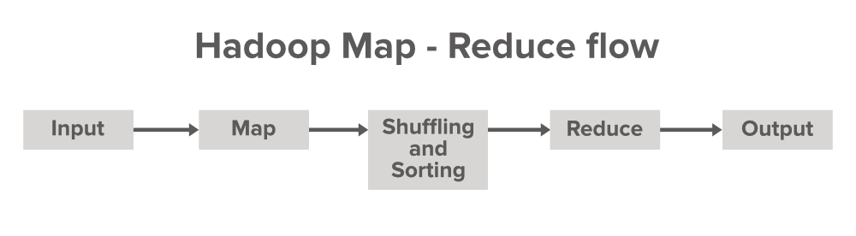
Hadoop Map Reduce
Hadoop MapReduce is a programming model and framework for processing large datasets in parallel across a cluster of computers
Two main phases
Map Phase: Taking input data and transforming it into a set of key-value pairs
Reduce Phase: Aggregates and summarizes the output of the Map function based on the keys

Slide 3

Apache Spark
An open-source, distributed computing system that is used for processing large datasets in parallel across a cluster of computers.
Fast, flexible, and easy to use
Provides a unified platform for a wide range of data processing tasks, including batch processing, machine learning, and stream processing
Resilient Distributed Datasets (RDDs) for fault tolerance and efficient data processing
Interactive and Supports a lot of languages such as Python, Scala etc

Slide 4
Mapreduce vs Spark
Spark | Mapreduce
Easy usage and interactive mode | Difficult usge and no interactive mode
Faster in memory mode (100 x hadoop) and Faster in disk mode (10 x hadoop) | Faster than traditional systems
Can self schedule tasks | Dependent on external job scheduler ex:Oozie
Less secure | More secure
Need to start from scratch if restarted | Can resume work after restarted
Can handle all data processing requirements | Ideal for batch processing
Cost is high | Cost is low

Slide 5
Setup
Setup:
Single Cluster
Spark
Jupyter
Hadoop
Single Dataset: Uploaded through a S3 bucket
Spark Analysis: Analyzed through PySpark
Hadoop Mapreduce Analysis: Hive Querying

Slide 6
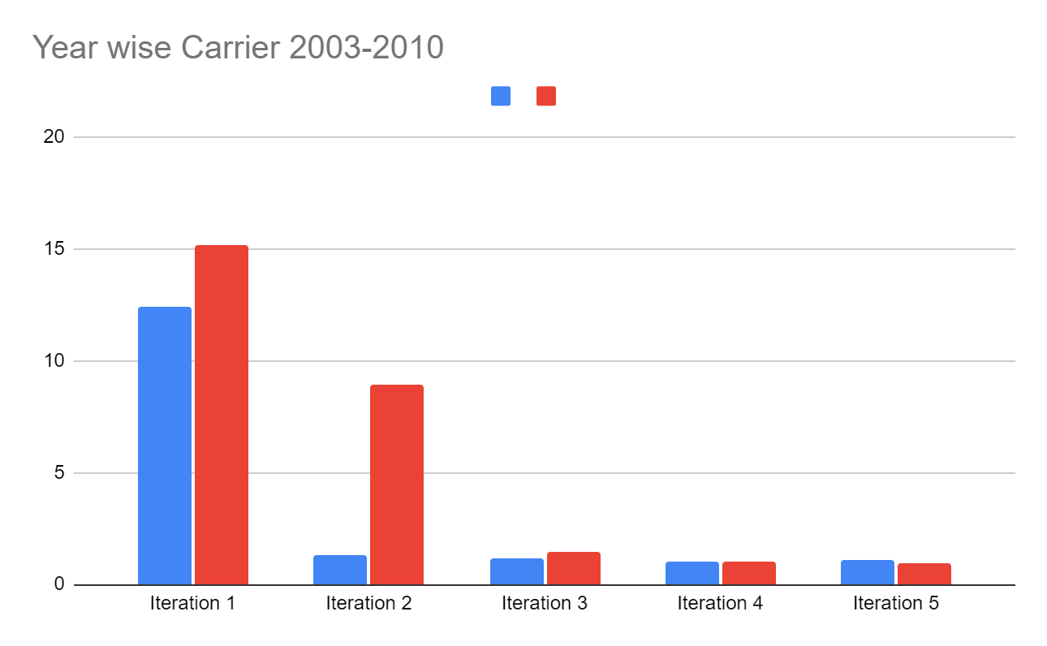
Carrier Delay Query
Spark Hive

Slide 7
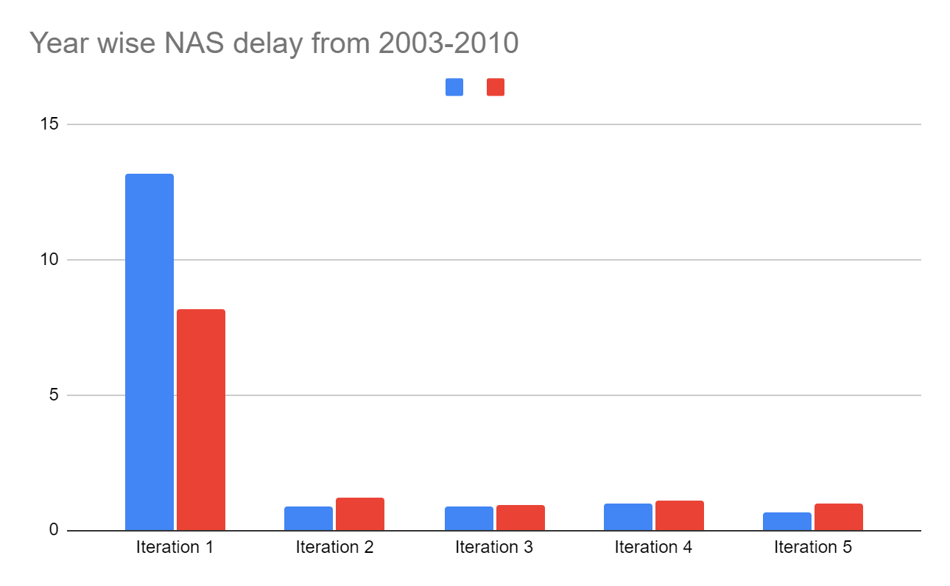
NAS Delay Query
Spark Hive

Slide 8
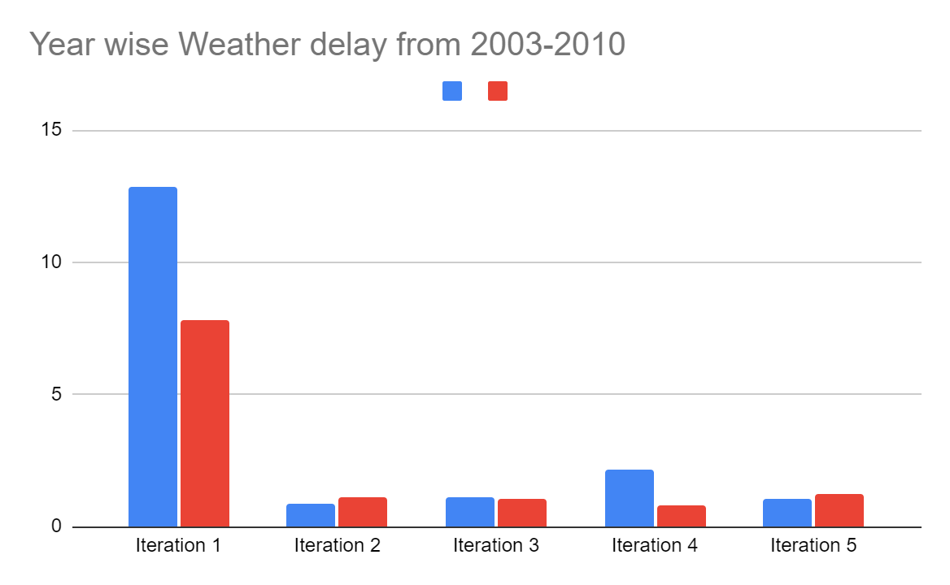
Weather Delay Query
Spark Hive

Slide 9
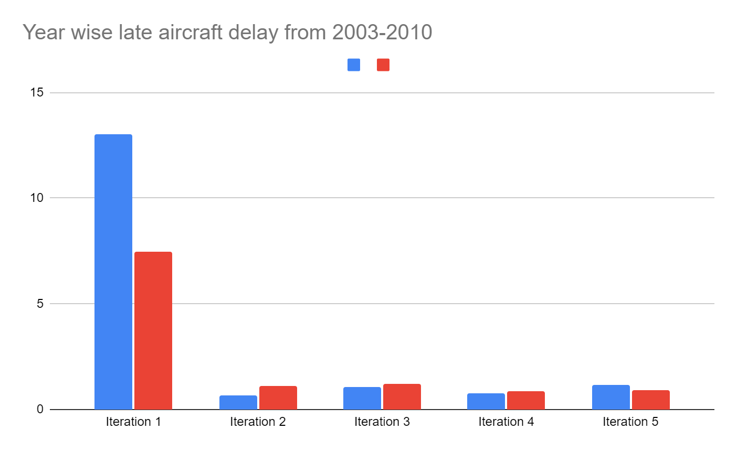
Late Delay Query
Spark Hive

Slide 10
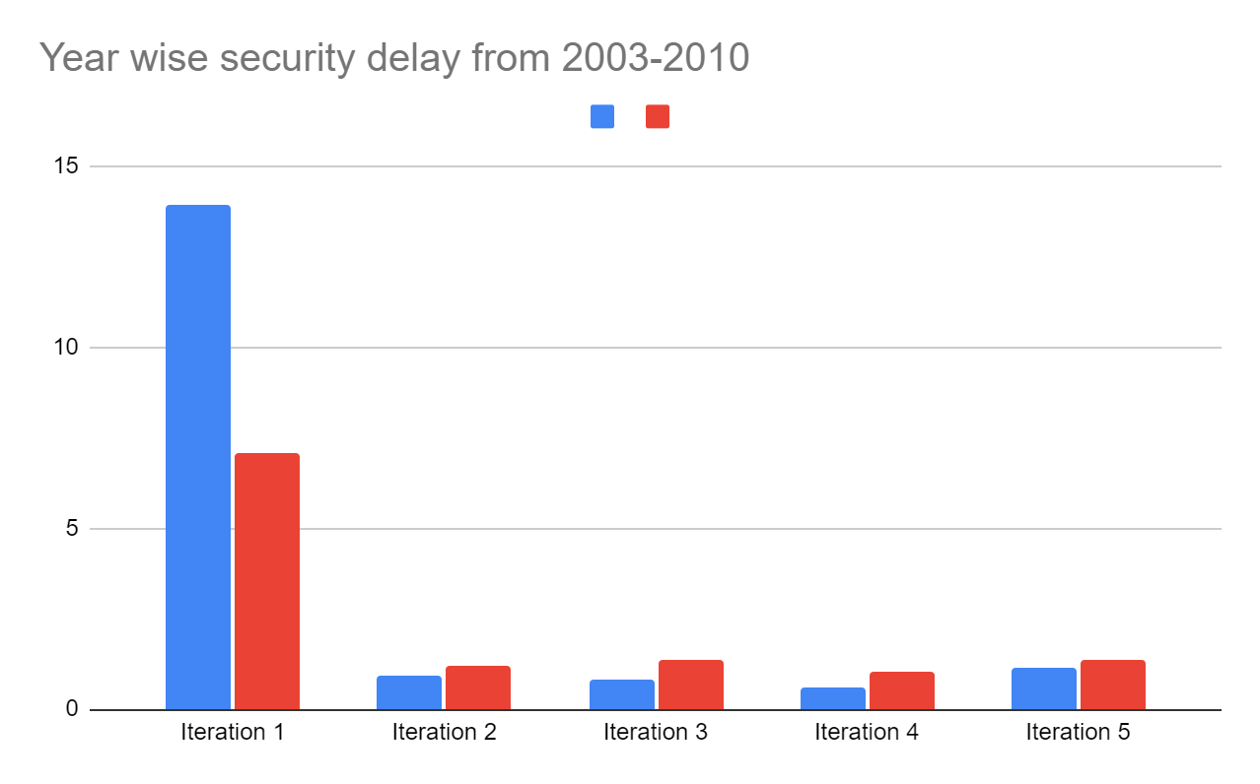
Security Delay Query
Spark Hive

Slide 11
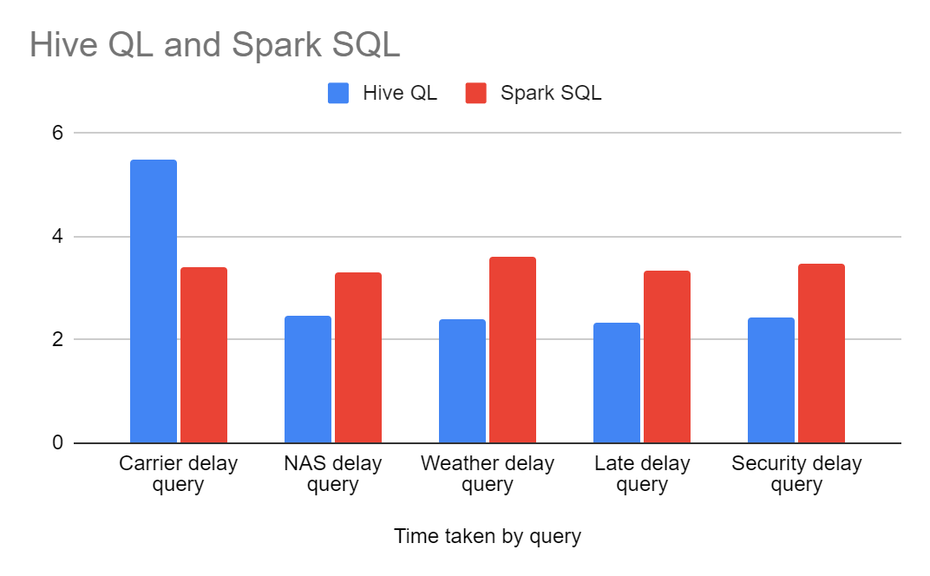
Average in iterations
Time taken by query | Hive QL | Spark SQL
Carrier delay query | 5.4996 | 3.395
NAS delay query | 2.4786 | 3.308
Weather delay query | 2.3974 | 3.605
Late delay query | 2.3174 | 3.345
Security delay query | 2.4196 | 3.487

Slide 12
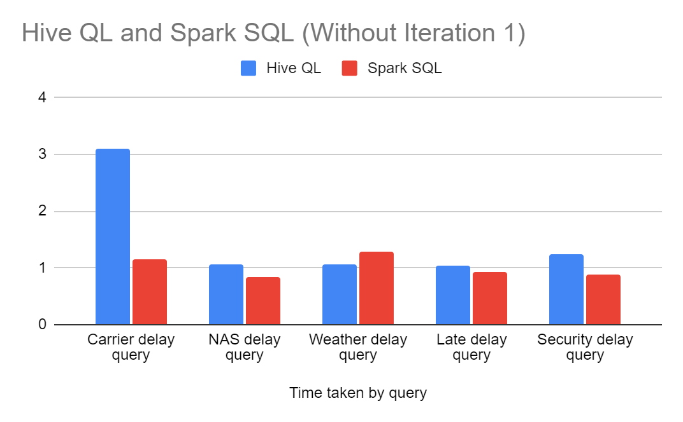
Averages ignoring first iteration
Time taken by query | Hive QL | Spark SQL
Carrier delay query | 3.08775 | 1.142
NAS delay query | 1.0595 | 0.847
Weather delay query | 1.0515 | 1.289
Late delay query | 1.03125 | 0.919
Security delay query | 1.24875 | 0.871

Slide 13
Conclusion
Spark is a lot more user friendly than Hive because of its interface and integrations
Since we were using a small data set external factors seem to affect more on the results
Overall average of hive was faster but when investigated properly we can see that spark is faster when considering execution time after first iteration.
We can observe that since edata is cached in memory and spark performs better

